Slide 1

CARVANA – Predicting the Purchase quality in Car Auction
Shanmuga Sundar
Shankar Prasaad
Kowshik Venkatesh
Mathu Balan

Slide 2
Outline
Prediction objective
Data Source
Data Visualization
Data Preprocessing
Model building and Improvization
Results

Slide 3
Objective
The Automobile industry gains a profitable income in the “Used Cars Segment” every year. AutoNation, a pioneer in this industry increased its revenue to $5.39 billion driven largely by 8.1 percent increase in Used cars revenue.
People who purchase used cars does it for cost cutting. Anyone who has limited funds would appreciate the need to save little cash.
There are so many factors that get into buying a used car such as – Range of Cost, Pre-purchase Inspection, Ownership Validation, Vehicle History Report and Age etc.
We try to tackle this problem by analyzing various factors behind the car and help the buyer realize if a particular auction purchase is a Good/Bad buy.

Slide 4
The Dataset
The dataset was obtained from Kaggle. The dataset was originally provided by Carvana, a Technology business start-up in Tempe, Arizona.
Carvana is an online used car dealer that sells and buys back used car through their website.
Carvana subsequently came with an idea to organize a competition in Kaggle, by providing the users their Purchase database with several key factors (i.e. car age, vehicle year, make , model, trim, Auction Average Price, Clean price etc.)
They key here is to analyze the 73k transactions from Carvana and come up with the prediction model that helps them understand whether a particular transaction is a Good/Bad buy.

Slide 5
DATASET DESCRIPTION
The dataset had a total of 34 attributes.
ReId – This is a Reference Id for each transaction in the dataset
PurchDate – Date attribute that specifies the date of Pruchase.
Auction – The Auction was help by two groups ADESA and MANHEIM. Other 3rd party dealers were also involved.
VehYear – The Year to which a particular model belongs.
VehicleAge – Number of years the vehicle is used.
Make – The vehicle company i.e. MAZDA, DODGE, FORD etc.
Model – Subclass from each Make i.e. FORD FOCUS, TOYOTA COROLLA etc.
Trim – The class distinction in each mode i.e ST, SXT, EX, SE etc.
SubModel – This is the type of Model i.e. 4D SEDAN, 2D COUPE, 4D SUV etc.
Color – Color of the vehicle
Transmission – AUTO or MANUAL

Slide 6
CONTD..
WheelTypeID – ID of different types of Wheel
WheelType – Type of wheel such as ALLOY, COVERS etc.
VEhOdo – Number of miles driven
Nationality – Make’s Nationality
Size – LARGE TRUCK, MEDIUM SUV etc.
TopThreeAmericanName – The original parent company that owns the Make ex- CHRYSLER, GENERAL MOTORS
MMR refers to the Manheim Market report prices
MMRAcquisitionAuctionAveragePrice – Acquisition price for this vehicle in average condition during purchase
MMRAcquisitionAuctionCleanPrice - Acquisition price for this vehicle in the above average condition during purchase
MMRAcquisitionRetailAveragePrice- Acquisition price for this vehicle in retail market in average condition
MMRAcquisitonRetailCleanPrice- Acquisition price for this vehicle in above average condition in the retail market

Slide 7
CONTD..
MMRCurrentAuctionAveragePrice – The current auction price for this vehicle in average condition
MMRCurrentAuctionCleanPrice – The current auction price of this vehicle in above average condition
MMRCurrentRetailAveragePrice - The current retail price for this vehicle in average condition
MMRCurrentRetailCleanPrice - – The current retail price for this vehicle in above average condition
PRIMEUNIT – Identify if the vehicle would have a higher demand than the standard purchase
AUCGUART – The guarantee level provided by the auction for the vehicle
BYRNO - The ID associated with each buyer
VNZIP1 - The zip code where the car was purchased
VNST – The state where the car was purchased
VehBCost – The initial base price for the vehicle at beginning of auction
IsOnlineSale- Whether the car was sold online or not
WarrantyCost- The cost of warranty for each vehicle

Slide 8

Dataset – Initial analysis
The dataset initially had 34 attributes with the target attribute being – IsBadBuy
The dataset had 19 numerical attributes and 15 categorical attributes and the shape and column can be seen below.
CATEGORICAL:
((72983, 15),
Index(['PurchDate', 'Auction', 'Make', 'Model', 'Trim', 'SubModel', 'Color',
'Transmission', 'WheelType', 'Nationality', 'Size',
'TopThreeAmericanName', 'PRIMEUNIT', 'AUCGUART', 'VNST'],
dtype='object’))

Slide 9

CONTD…
NUMERIC:
((72983, 19),
Index(['RefId', 'IsBadBuy', 'VehYear', 'VehicleAge', 'WheelTypeID', 'VehOdo',
'MMRAcquisitionAuctionAveragePrice', 'MMRAcquisitionAuctionCleanPrice',
'MMRAcquisitionRetailAveragePrice', 'MMRAcquisitonRetailCleanPrice',
'MMRCurrentAuctionAveragePrice', 'MMRCurrentAuctionCleanPrice',
'MMRCurrentRetailAveragePrice', 'MMRCurrentRetailCleanPrice', 'BYRNO',
'VNZIP1', 'VehBCost', 'IsOnlineSale', 'WarrantyCost'],
dtype='object'))

Slide 10
PROBLEMS FACED - MISSING VALUES
ATTRIBUTE NAME | MISSING VALUES
Trim | 2360
SubModel | 8
Color | 8
Transmission | 9
WheelTypeID | 3169
WheelType | 3174
Nationality | 5
Size | 5
TopThreeAmericanName | 5
MMRAcquisitionAuctionAveragePrice | 18
MMRAcquisitionAuctionCleanPrice | 18
MMRAcquisitionRetailAveragePrice | 18
MMRAcquisitonRetailCleanPrice | 18
MMRCurrentAuctionAveragePrice | 315
MMRCurrentAuctionCleanPrice | 315
MMRCurrentRetailAveragePrice | 315
MMRCurrentRetailCleanPrice | 315
PRIMEUNIT | 69564
AUCGUART | 69564
The Initial analysis showed that the dataset had 19 Attributes with missing values. The statistics for the missing values are.
Attributes PRIEUNIT and ACGUART had only less than 10% percent of data and did not help enough with model building and were removed in the analysis.

Slide 11
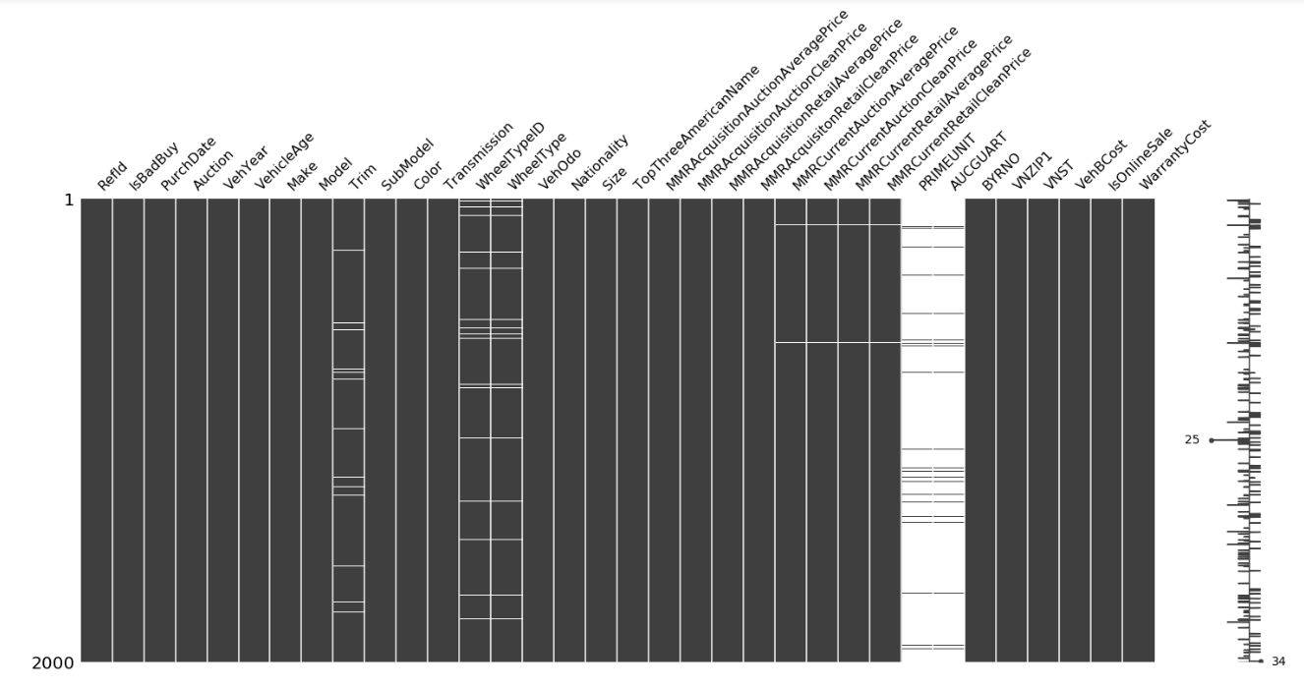
VISUALIZATION OF THE MISSING DATA

Slide 12
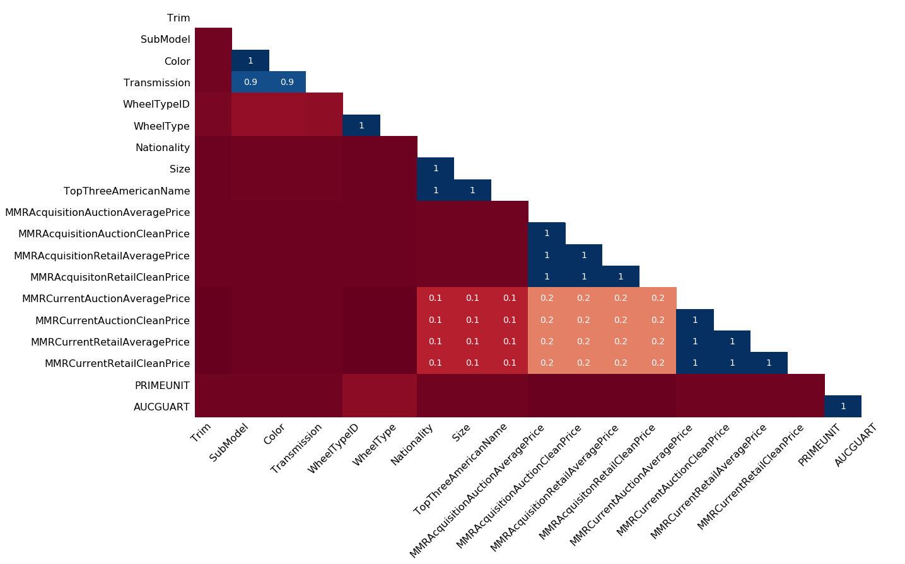
NULLITY CORRELATION FOR MISSING VALUES

Slide 13
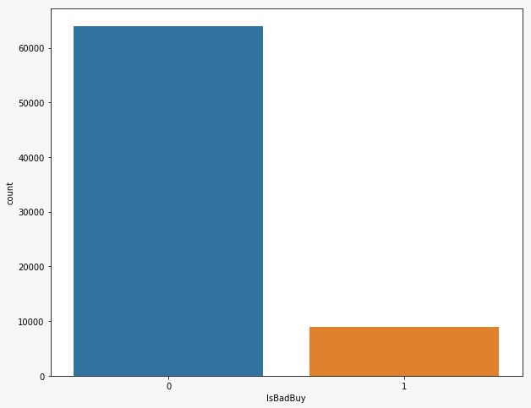
PROBLEM FACED – Class Imbalance
The original dataset is highly class imbalanced
Only 10 percent of the transaction were a BAD buy and the rest were GOOD buy

Slide 14
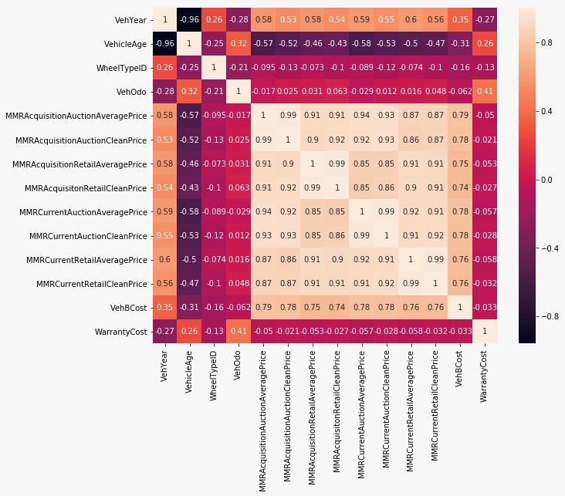
CORRELATION MATRIX HEATMAP

Slide 15
DATA VISUALIZATION

Slide 16
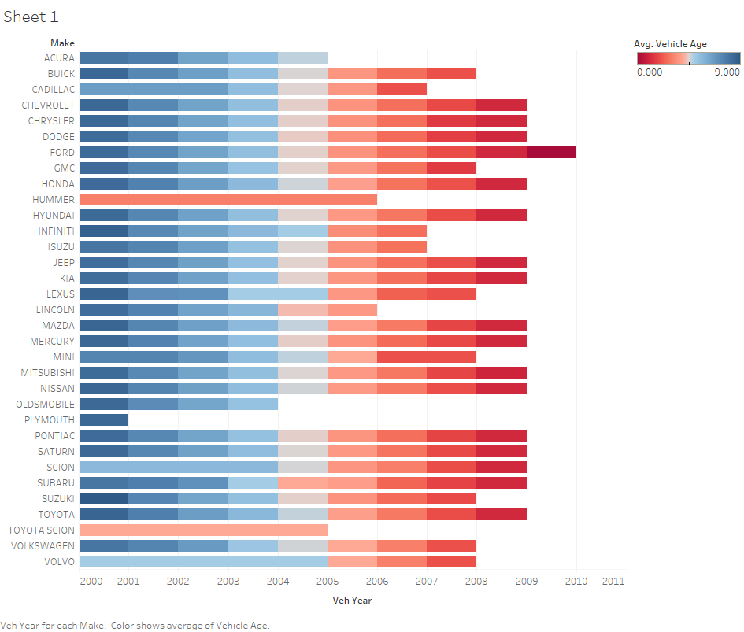
Vehicle year for each make. Color shows the average age of vehicle

Slide 17
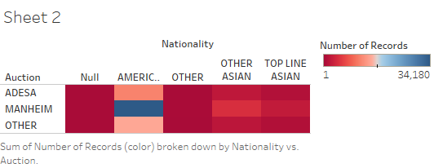
The number of Cars purchased by the Auction Company vs Make of Car Purchased by Nationality

Slide 18
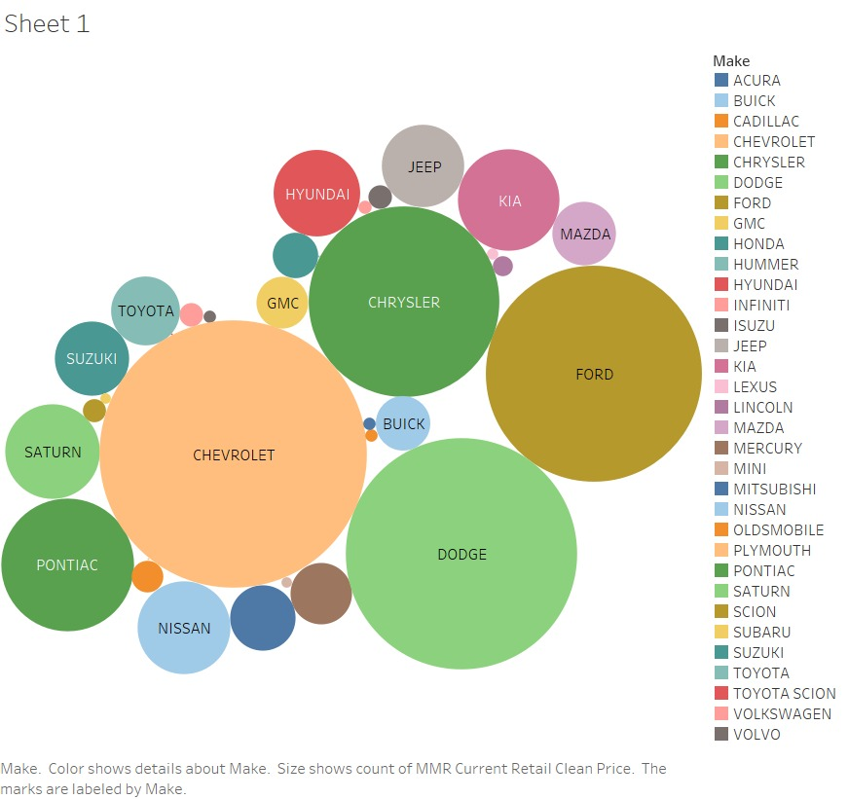
Color shows the details about the make Size of Circle explains the count of MMR Current Retail price.

Slide 19
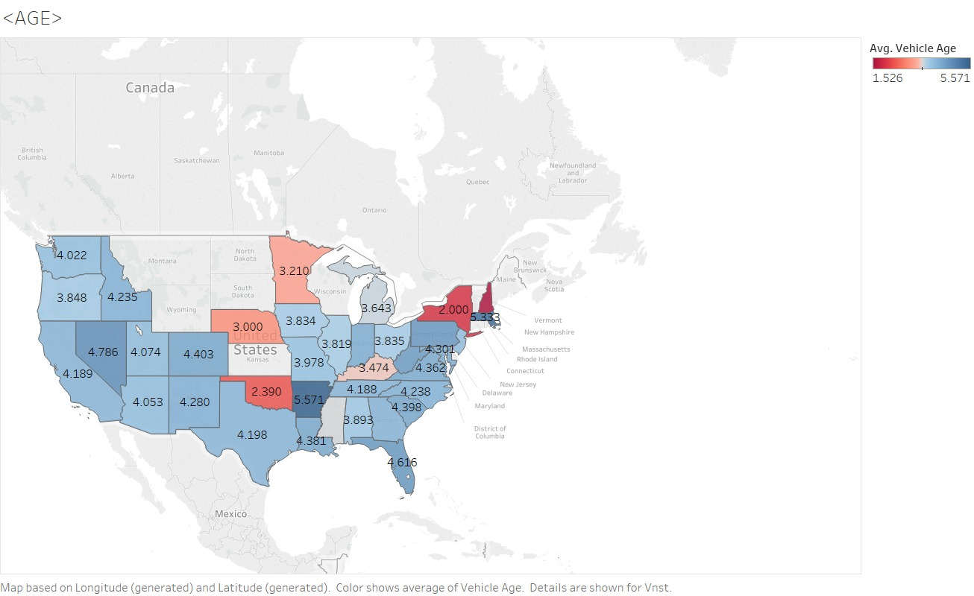
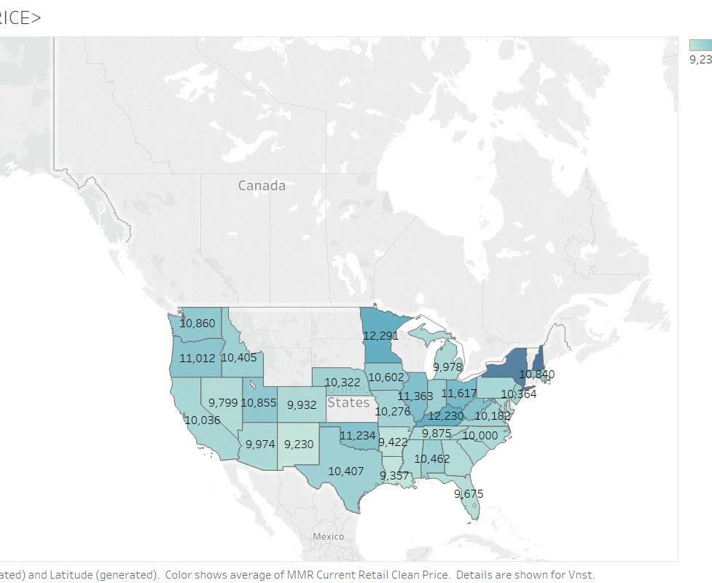
Color shows the average of current retail price in each state
In Second graph Color shows the Average Age of vehicle in each state

Slide 20
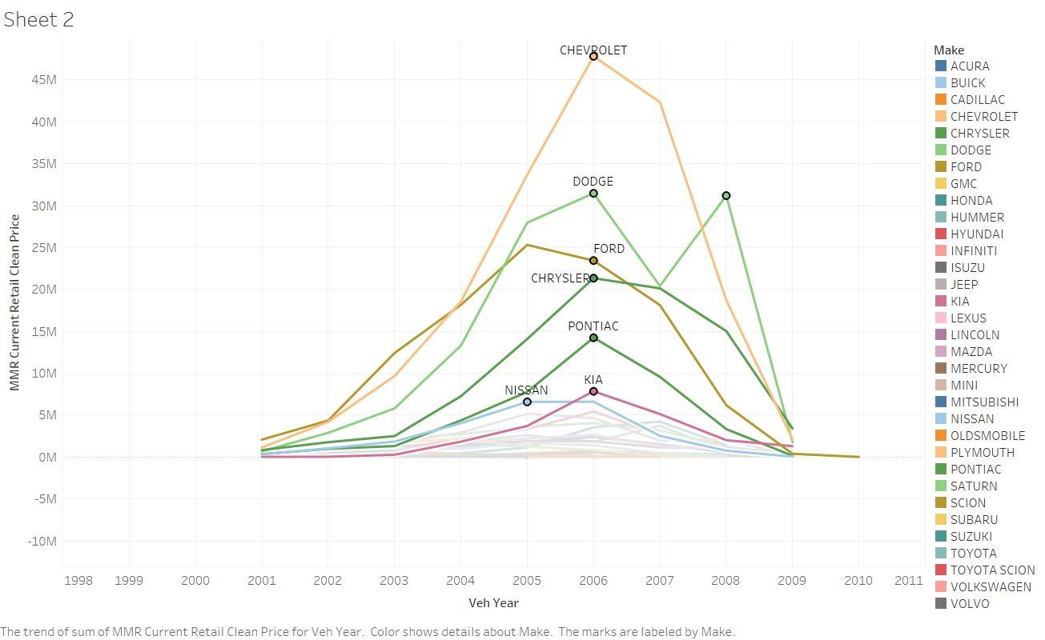
The trend of sum of MMR Current Retail price for each make and Vehicle Year

Slide 21
DATA PREPROCESSING

Slide 22

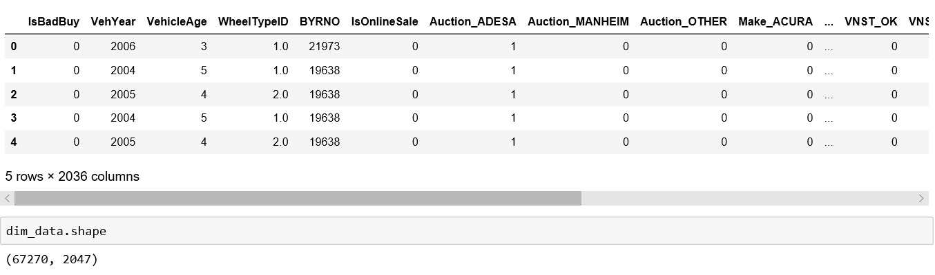
REMOVING THE INSIGNIFICANT FEATURES
The attributes PRIMEUNIT and AUCGUART had less than 1 percent of data and were found inefficient in predicting the target variable.
The preliminary data analysis showed that we had 15 Categorical variables. Now after removing the above 2 features we are left with 13 Categorical variables now.
We used One-hot Encoder to create dummy values for the Categorical variables.

Slide 23
CONTD..
We also removed the numerical variables VNZIP1 and RefId.
VNZIP1 was jus the zip codes of where the cars were sold. This is redundant because, we can infer this from the variable VNST(sate codes). RefId is just a transaction ID which had no meaning.

Slide 24
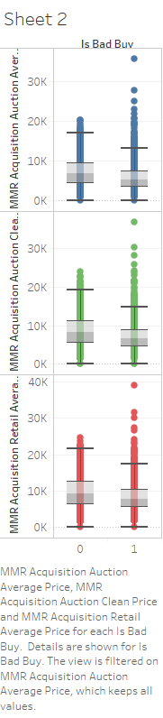
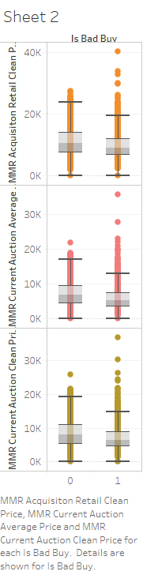
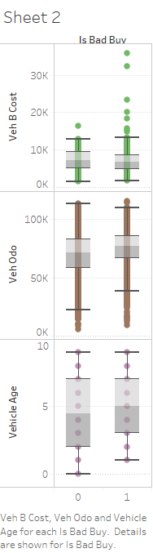
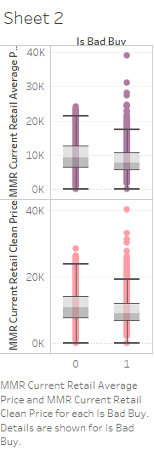
REMOVING OUTLIERS
We removed the outliers from the continuous variables. This can be inferred from the boxplots below.

Slide 25
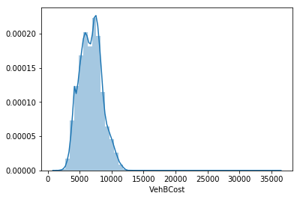
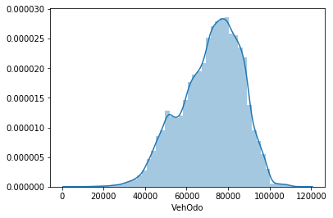
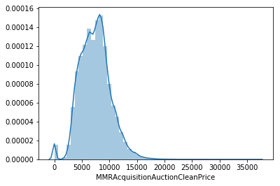
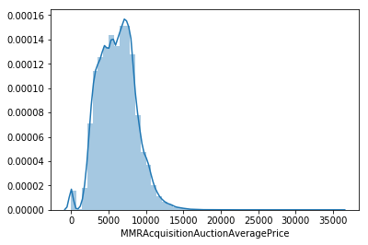
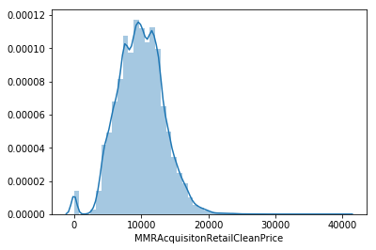
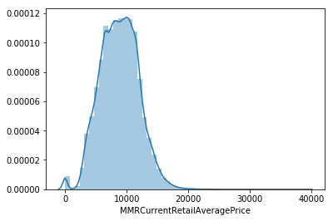
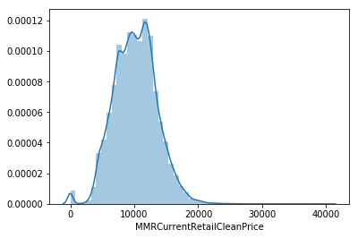
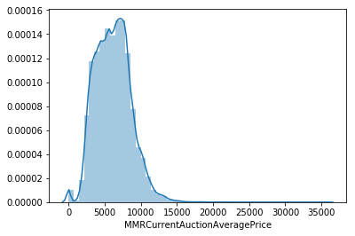
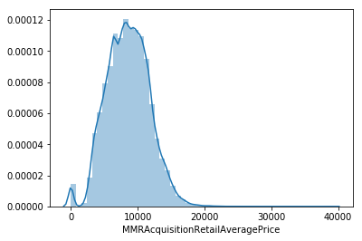
DISTRIBUTION PLOTS We used distribution plots to check the normality of the continuous variables.

Slide 26
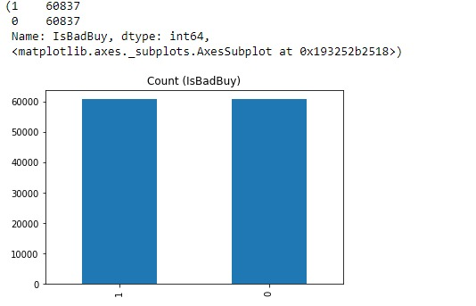
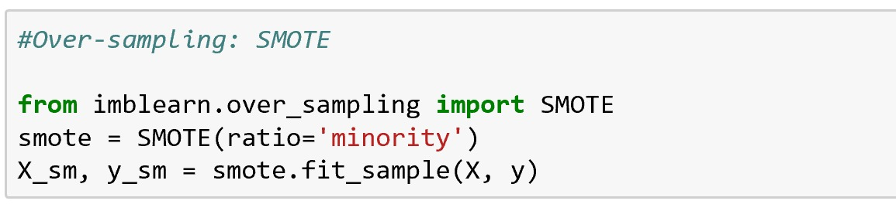
SMOTE FOR CLASS IMBALANCE
We used SMOTE technique to solve the class imbalance problem.

Slide 27
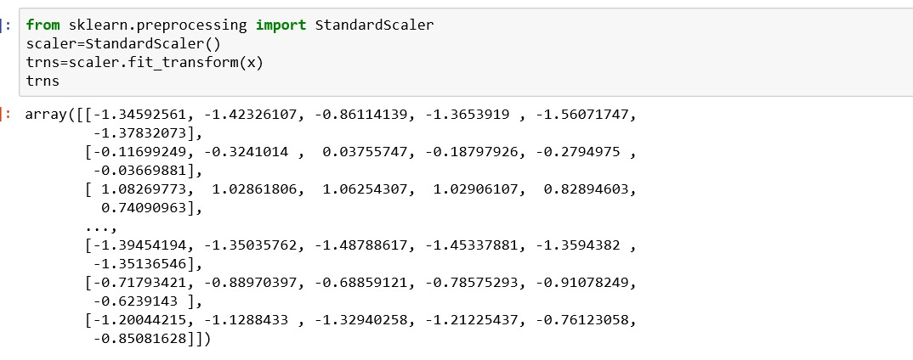
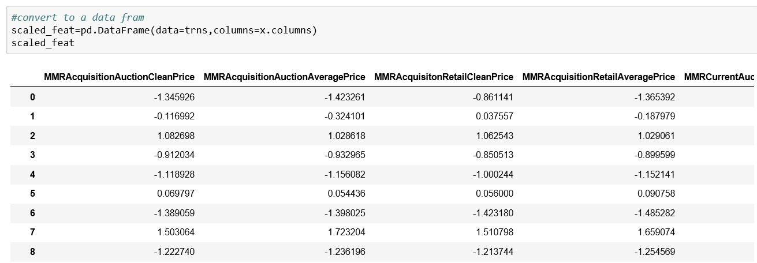
STANDARDIZATION OF FEATURES USING SCALING
We used Standard Scalar to perform standardization so that all the numerical variables fall in the same scale throughout the dataset.

Slide 28
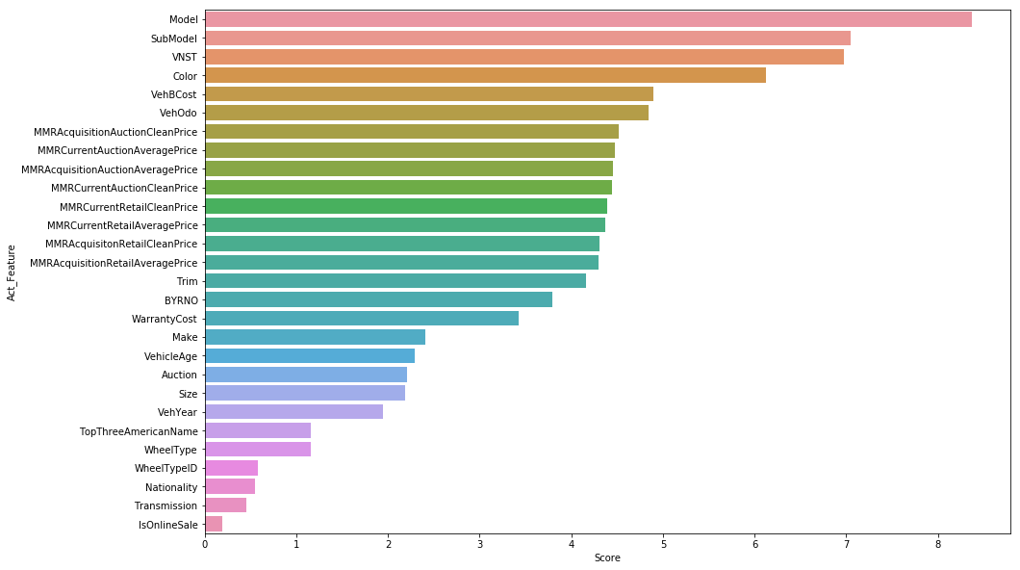
FEATURE ENGINEERING- Random Forest

Slide 29
MACHINE LEARNING MODELS

Slide 30
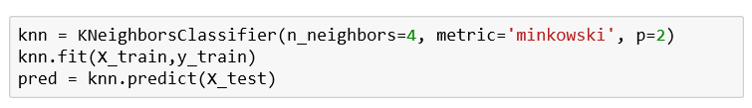
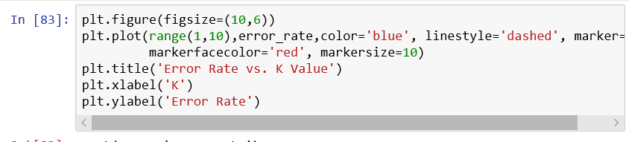
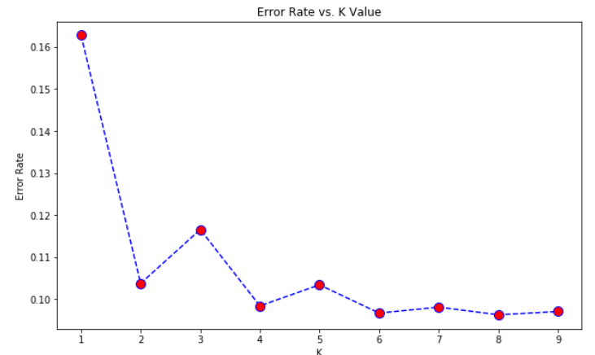
K Nearest Neighbor
Parameter Tuning:
N_Neighbors
Distance Measure
a. p=0 Minkowski
b. p=1 Manhantan
c. p=2 Eulidean

Slide 31
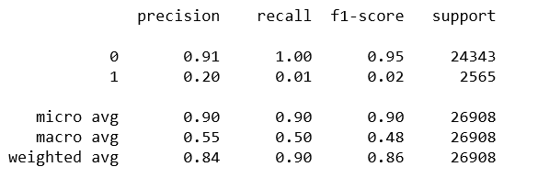
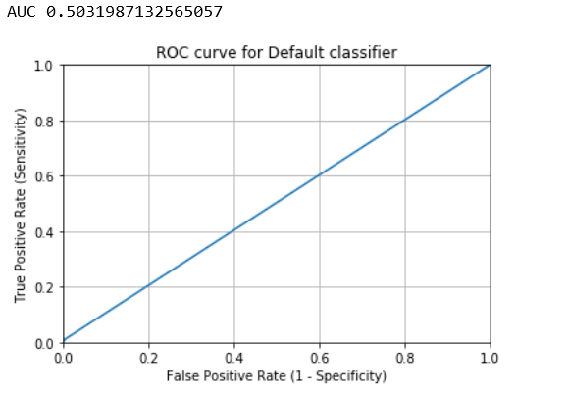
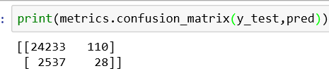
KNN – Report
Training Score – 90.4
Testing Score – 90.5

Slide 32
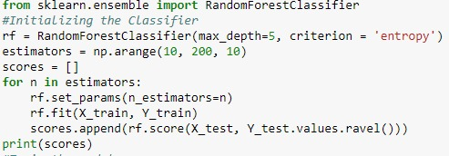
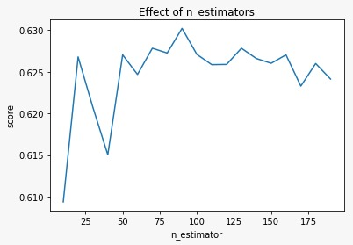
Random Forest
Version:
Original Data
SMOTE+ RF
Oversampling+ RF
Under Sample+ RF
Parameter Tuning:
n_estimators
Criterion
max_depth
max_feature

Slide 33
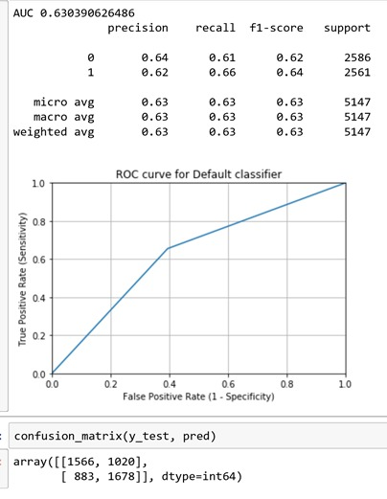
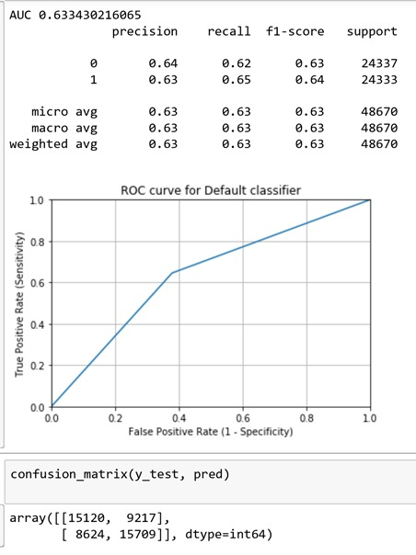
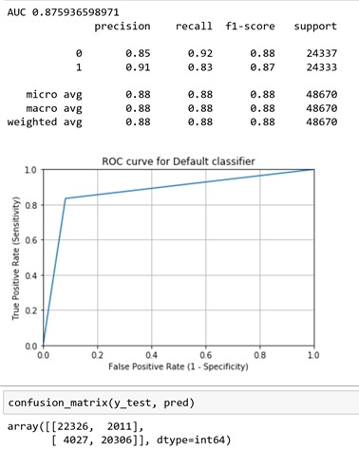
Random -Under Sampling
Random – Over Sampling
Over Sampling – SMOTE

Slide 34
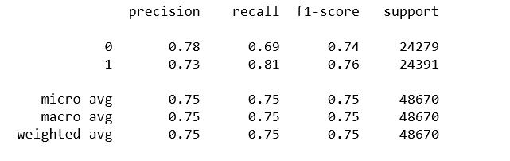
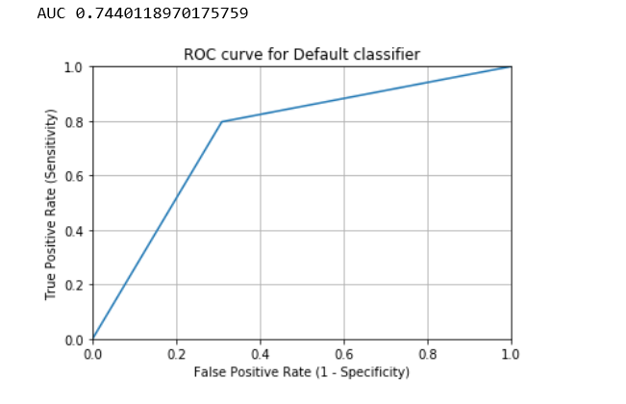
Ensemblem – Ada Boosting
Parameter Tuning
Weak Learning – Decision Tree
criterion = “entropy”
Max_depth = 5
Random_state
Algorithm= SAME.R – Real Boosting

Slide 35
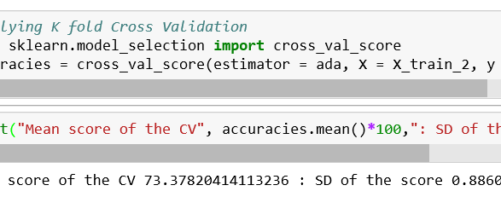
K Fold Cross Validation – Ada Boosting

Slide 36
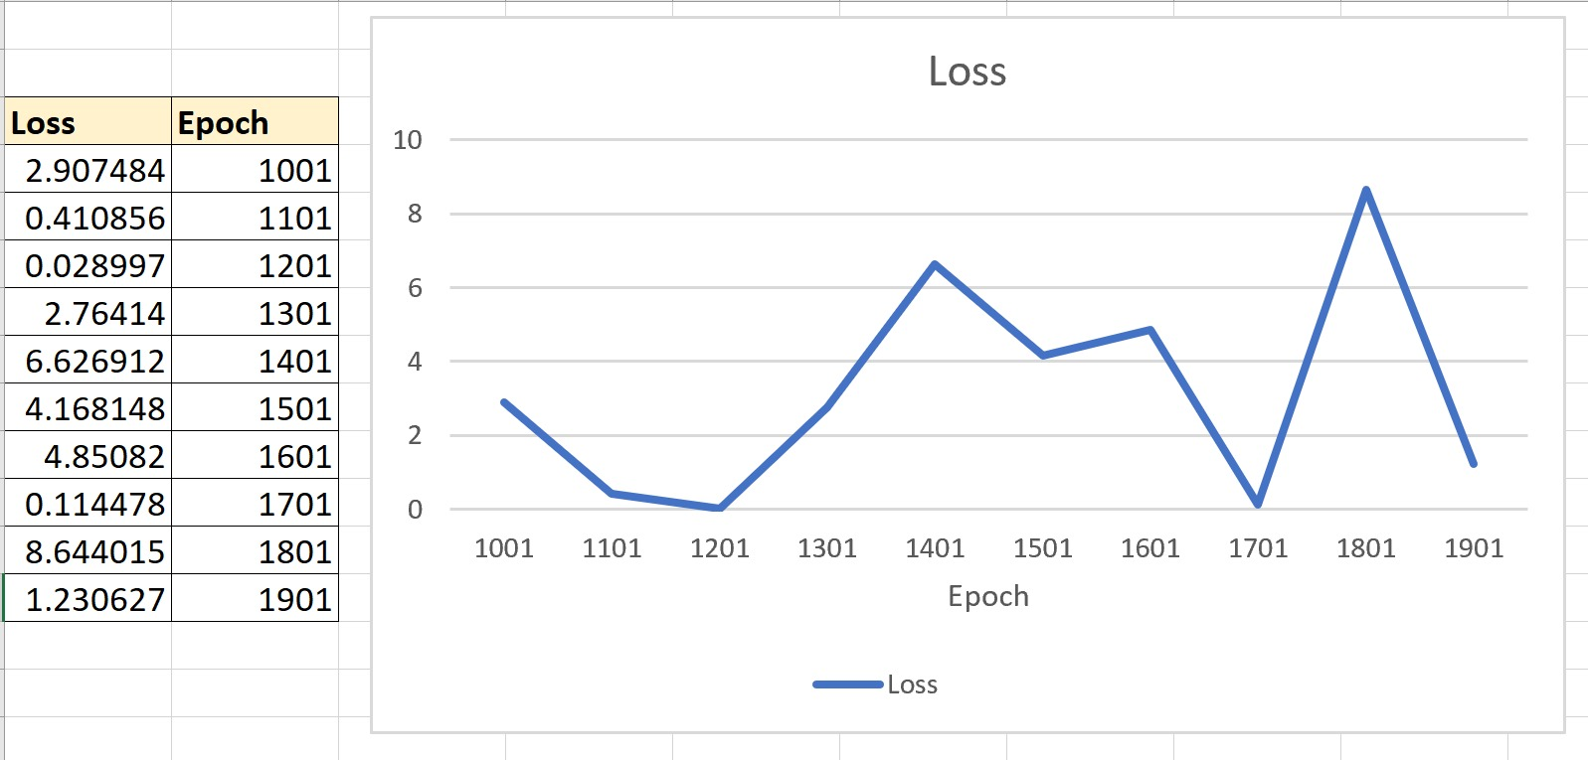
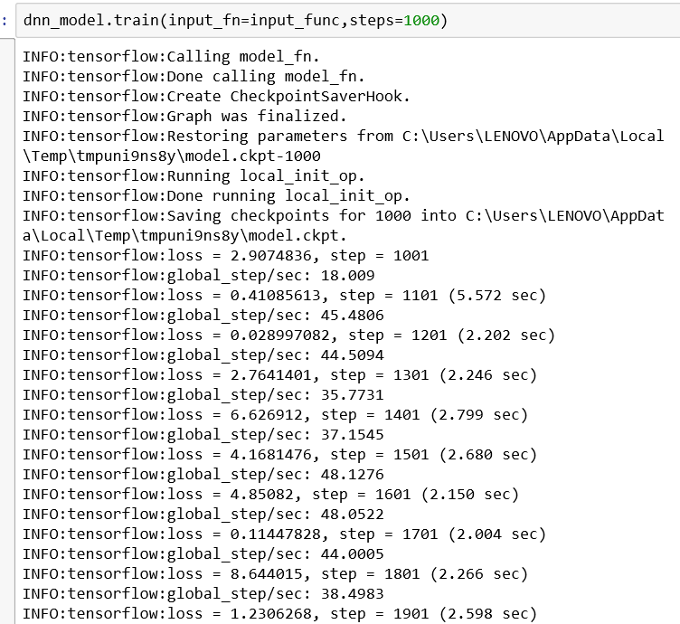
DEEP NEURAL NETS- Tensor Flow
Parameter Tuning:
Activation Function – Relu
Hidden Layer - Three
Number of Neuron – 27 each Layer
Loss Function - Cross Entropy
Learn Rate Optimization – Adam Optimization
Optimization – Stochastic Gradient
Regularization – DropOut

Slide 37
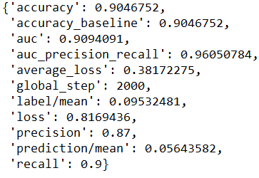
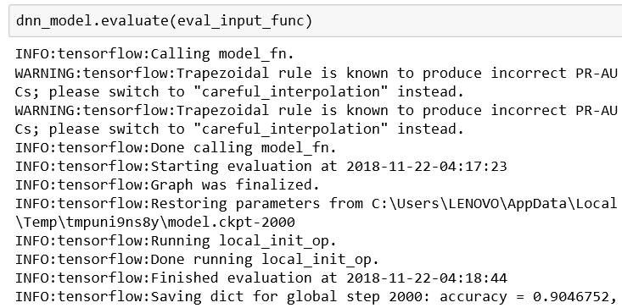
DNN – Report

Slide 38
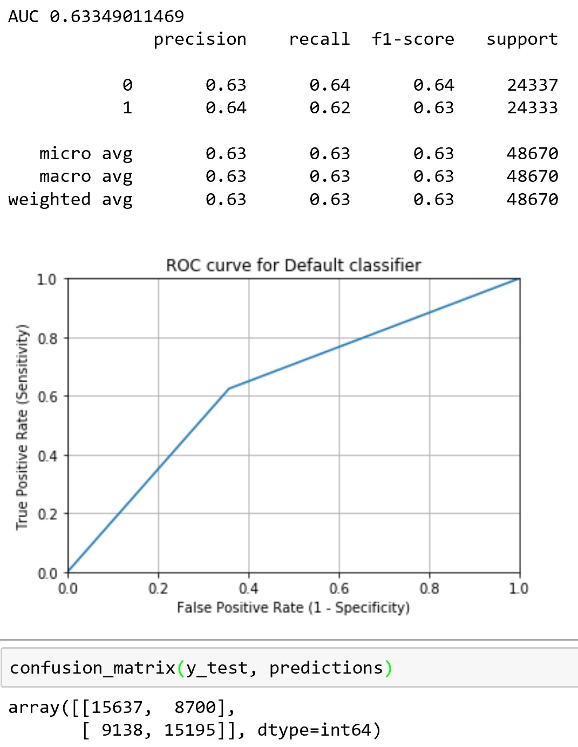
Logistic Regression
Parameter Tuning:
C: The Higher C the model is less Regularized.
Training Score – 63.61
Testing Score – 63.34

Slide 39
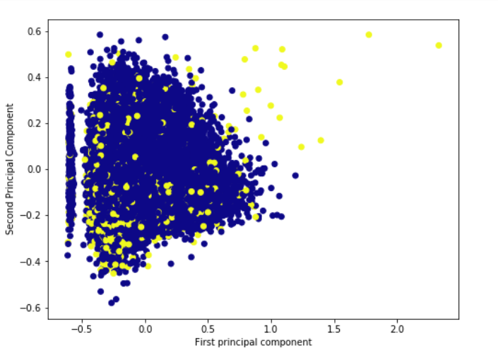
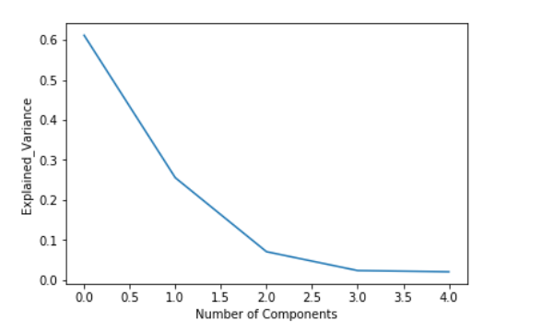
PCA – Principal Component Analysis
Parameter Tuning
Number of Components --- Elbow plot
Explained variance vs Number of components

Slide 40

PCA- COMPONENTS FEATURE VARIANCE

Slide 41


PCA+SMOTE+RF

Slide 42

CHALLENGES FACED – Algorithm
SVM
Parameter Tuning
C , gamma , Kernal.
Grid Search
C=[0.1,1,10,100]
Gamma=[1,0.1,0.01,0.0001]
Kernel- rbf.
Time Execution – More than 12 hours , for 25 fits out of 75 fits

Slide 43
Challenges Faced – Data
Data Imblance – Random Over Sampling, Random Under Sampling, SMOTE.
Distribution of Continous Variable – Applied Log Transformation
Over Fitting – K fold cross validation, HyperParameter Tuning.
Dimensionality – PCA

Slide 44
SUMMARY
Model | Train Score | Tesing Score | Precision | Recal | AUC
Knn+SMOTE | 90.4 | 90.5 | 0.84 | 0.9 | 0.5
RF | 75 | 50 | 0.65 | 0.45 | 0.5
RF+ UnderSample | 65.3 | 63 | 0.63 | 0.63 | 0.63
RF+ OverSample | 63.9 | 63.3 | 0.63 | 0.63 | 0.63
RF+Over Sampling SMOTE | 87.6 | 87.5 | 0.88 | 0.88 | 0.875
Ada Boosting | 92.5 | 75.65 | 0.75 | 0.75 | 0.74
DNN | 94.5 | 95.4 | 0.84 | 0.9 | 0.9
Logisti Regression | 63.61 | 63.64 | 0.63 | 0.63 | 0.633
PCA+SMOTE+RF | 76.5 | 76.5 | 0.76 | 0.8 | 0.76

